Slide 1
Code-to-Code translation from Java to Python using CodeBERT and CodeT5 models
Presented By:
Arnav Chhabra
Harsha Vardhan Reddy Bonthu

Slide 2
Problem Statement
Code-to-Code translation from Java to Python using deep learning models
We used CodeBERT (bimodal) and CodeT5 (encoder-decoder) models and compared the results with Transcoder (Seq2Seq)
Extracted the data from different competitive programming sites and used the appropriate language parser techniques to enable conversion from Java functions to Python functions

Slide 3
Dataset
Extracted Java and Python functions from the following sources:
GeeksforGeeks
Leetcode
Codeforces
Atcoder
Google CodeJam
Project Euler

Slide 4
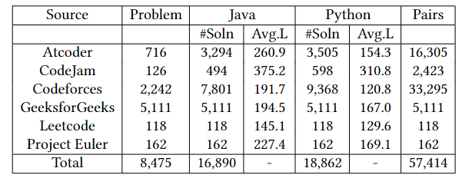
Dataset Description

Slide 5
Dataset Pre-Processing
Tokenize the java and python codes
Remove the comments and docstrings from the code.
Javalang tokenizer for the Java code
Standard python library tokenizer for the Python Code
Ensured the length of the java and python functions was the same using truncation/padding.

Slide 6
CodeBert Model
Uses a multi-layer bidirectional Transformer architecture.
The model has been pre-trained in the following programming languages Python, Java, JavaScript, PHP, Ruby and Go
Understands the semantic relationships between natural language and programming languages.
The model is pre-trained using Masked Language Modeling and Replaced Token Detection techniques

Slide 7
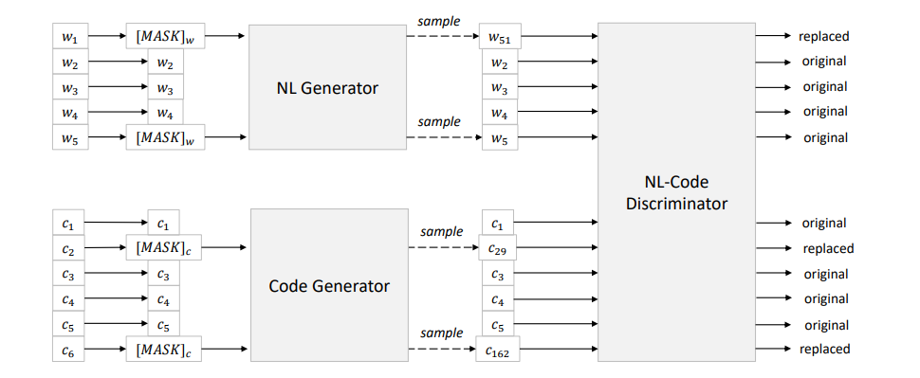
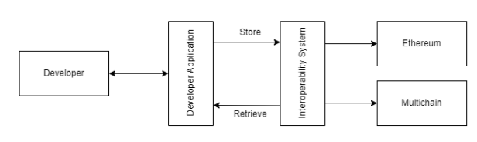
CodeBert Model Architecture

Slide 8
CodeT5 Model
Uses an encoder-decoder architecture. With pre training both the components of the model.
Gets understanding of natural language and programming languages using unlabelled data.
Completes pre training using masked span prediction, identifier tagging, masked identifier prediction and bimodal dual generation.

Slide 9
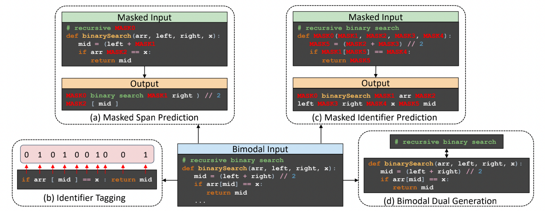
CodeT5 Pre Training

Slide 10
Transcoder
TransCoder employs a sequence-to-sequence (seq2seq) model with attention, which consists of a transformer-based encoder and decoder.
It is trained utilizing the initialization, language modeling, and back-translation methods of unsupervised machine translation.
It uses a Denoising Auto-Encoding (DAE) objective to train the model to encode and decode sequences.

Slide 11
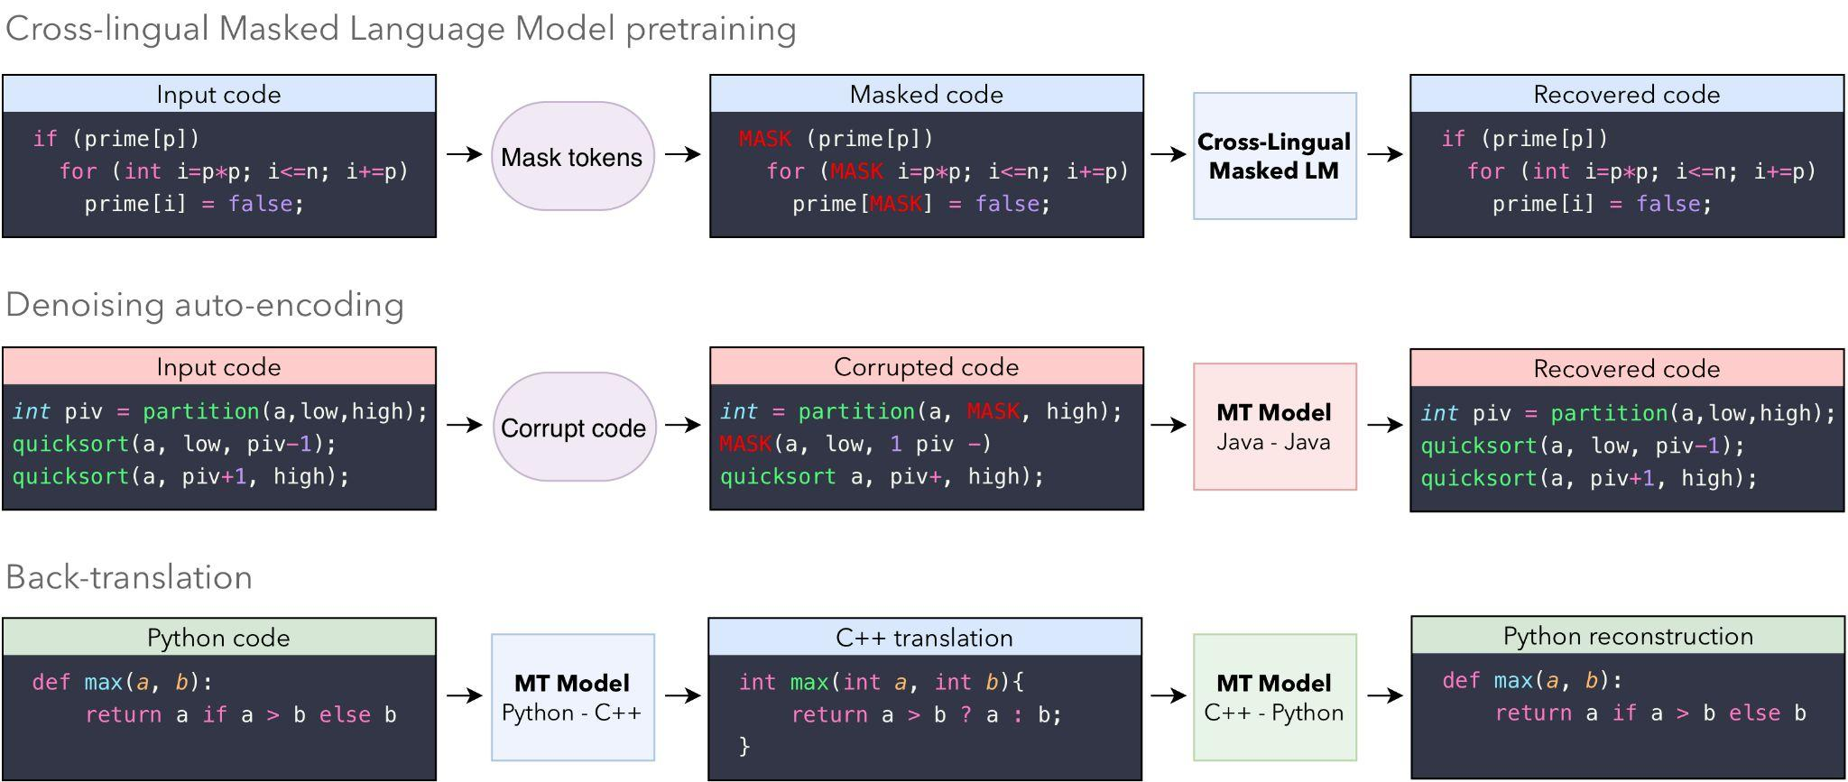
Transcoder Principles

Slide 12
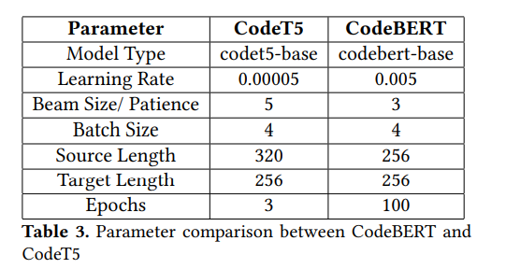
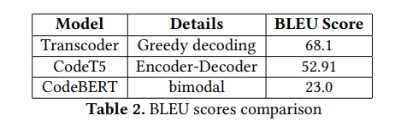
Evaluation

Slide 13
Lessons Learned
Learnt about different types of code-translation models and their techniques.
Understood the working of the models and analyzed their performance.
Considered the ethical aspects of software engineering tasks
Realized that training the models take a large amount of time, even with powerful GPUs.

Slide 14
Broader Impacts
Help improve the speed and of the process of transitioning from legacy systems to modern systems.
Allows developers to share code functionalities across different programming languages.
Promotes the use of latest technologies as it reduces the cost and time of legacy system transitions to help create more reliable and secure software application.

Slide 15
THANK YOU !!

